Slide 1
Pro-Caffeinating: Everything we brew, we brew it for you
Daisy Nava, Karlyn Baird, Linda Ziolkowski
Website: https://daisyn25.wixsite.com/pro-caffeinating

Slide 2

What is Pro-Caffeinating?
We are a two coffee houses located in the West Chicago Suburbs. We offer fair trade coffee from around the world in a comfortable atmosphere.
You can sit and enjoy a delicious cup of fair trade coffee, or buy our coffee beans by the pound for yourself at home.
Our coffee shop offers wifi and places for you to relax by yourself or catch up with friends.

Slide 3
Who Started Pro-Caffeinating?
Pro Caffeinating was started in 2017 by three Registered Dietetic Students who were completing their Master’s of Business Administration degrees at Dominican University. Their love of coffee and desire to help people around the world lead to their idea of creating a fair trade coffee shop. Their mission of humanitarian efforts is part of their very business strategy.

Slide 4
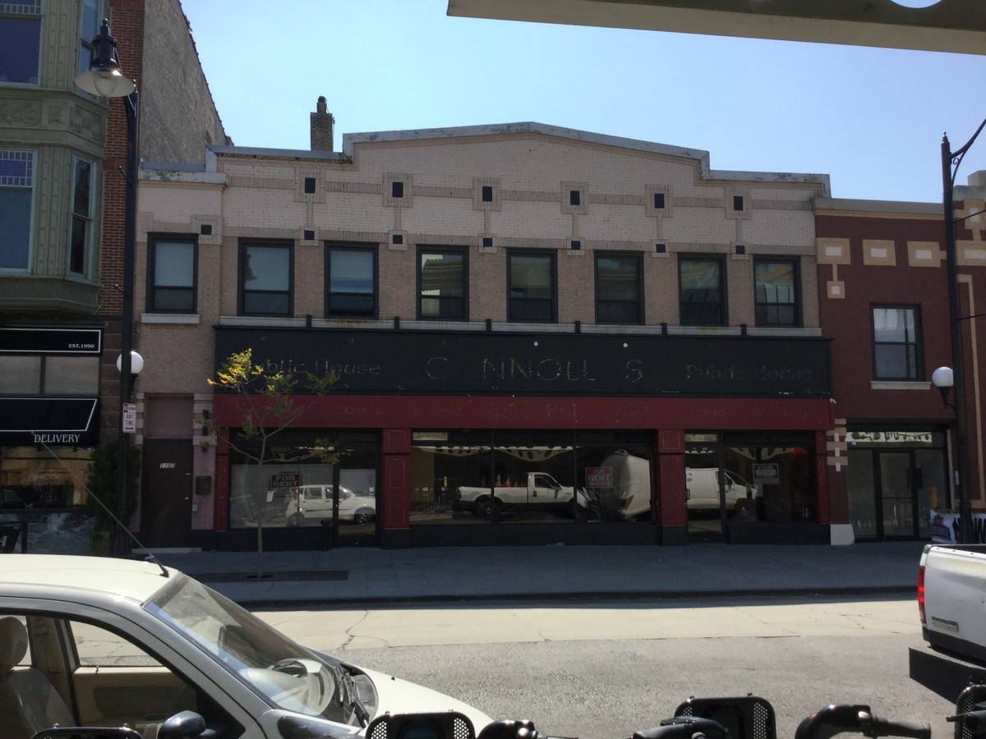
Where We Are:
Pro-Caffeintating is located Oak Park:
Oak Park is located only 10 miles from Downtown Chicago. The town is home to two colleges, a popular high school, and many families reside in the area.

Slide 5
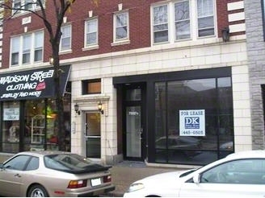
Where We Are:
Pro-Caffeintating is located Forest Park:
Forest Park is located only 10 miles from Downtown Chicago. The area has two colleges, a popular high school, and many families reside in the area. Located on Madison street, it is a popular shopping area.

Slide 6

Our Mission:
Our Mission as a business is to bring delicious fair trade coffee to the Western Suburbs of Chicago, while also promoting a pay it forward and ethical buying standards.

Slide 7
Our Pay it Forward Mission:
Pro-Caffeintating wants to make the world a better place, and part of that plays into our pay it forward mission. When you come into Pro-Caffeinating, you will see notes on our wall.
If you would like a cup of coffee but cannot afford it, simply take a note from the wall and present it to the cashier. These notes are supplied by our thoughtful customers who have purchased another cup of coffee for another patron.
We want everyone to feel welcome and enjoy our coffee, and hope that to make the world a better place in the process.

Slide 8

Our Target Demographic:
Pro-Caffeintating wants everyone to come into our shop to enjoy our coffee. We welcome anyone who wants ethically traded great tasting coffee into our shop and hearts. We appeal mostly to middle to upper middle class working age adult coffee drinkers, but will welcome anyone who wants to get into the coffee scene as well.

Slide 9
Our Menu:
Our Fair Trade Coffee:
Ethiopia
Columbia
Costa Rica
Mexico
Rwanda
Guatemala
Brazil
Dominican Republic
Fair Trade Espresso Shots
Enjoy a cup of coffee for $2.50 with refills, cream, and sugar. One shot of Espresso will be priced at $1.50/ea shot.
1 lb of coffee beans varies per coffee:
Ethiopia: $20
Columbia: $20
Costa Rica: $17
Mexico: $22
Rwanda: $25
Guatemala: $22
Brazil: $30
Dominican Republic: $17
Espresso: $15

Slide 10
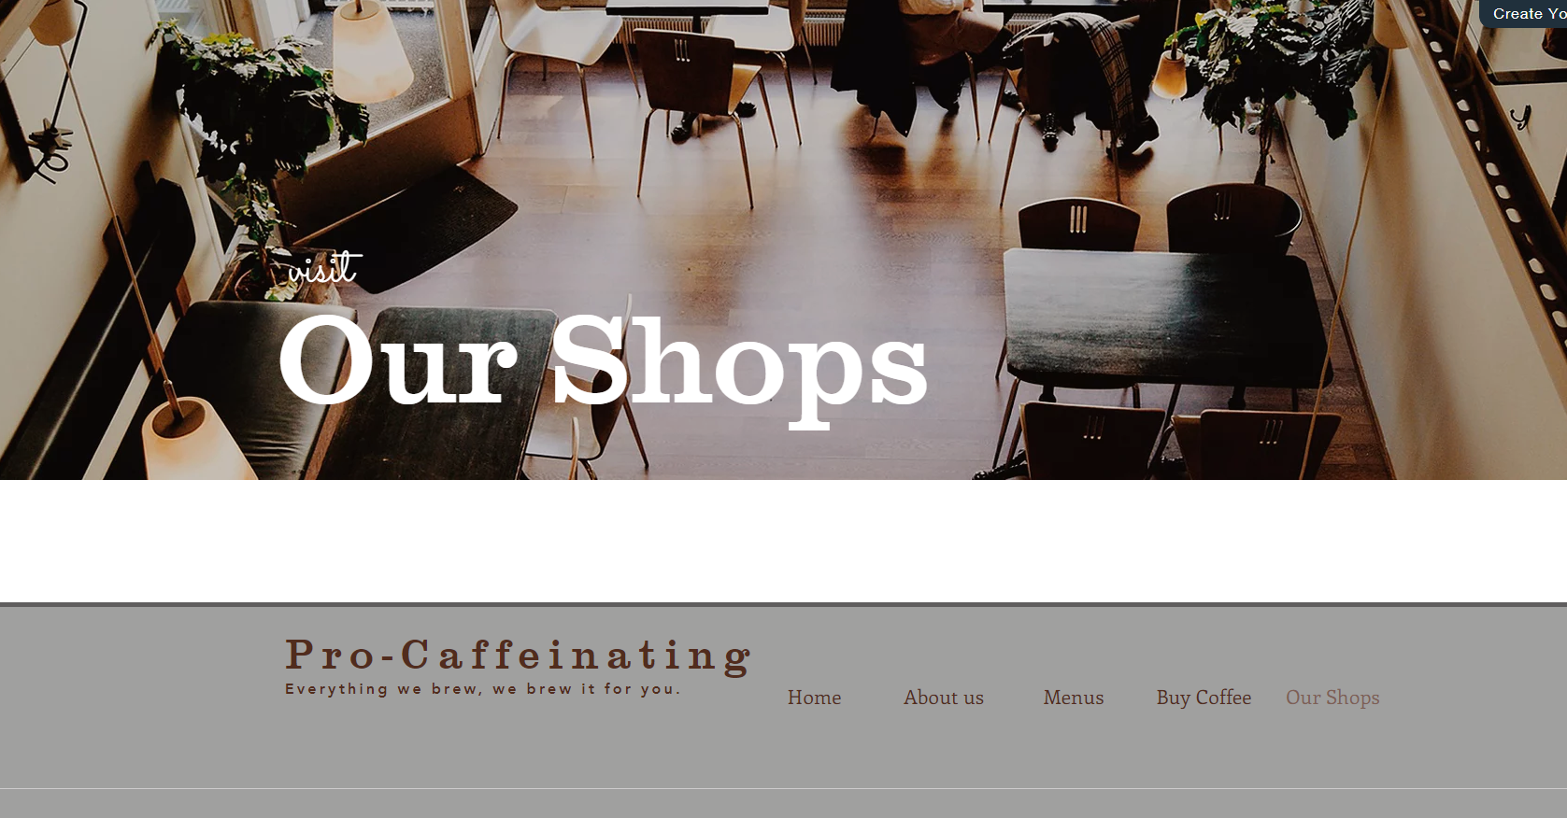
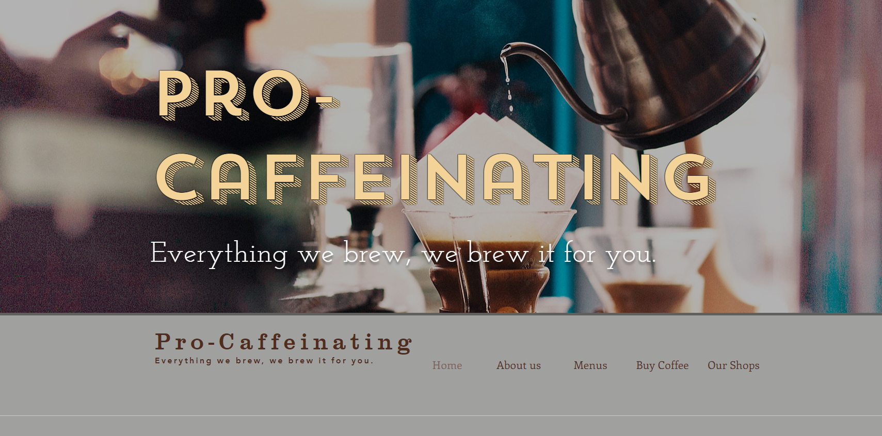
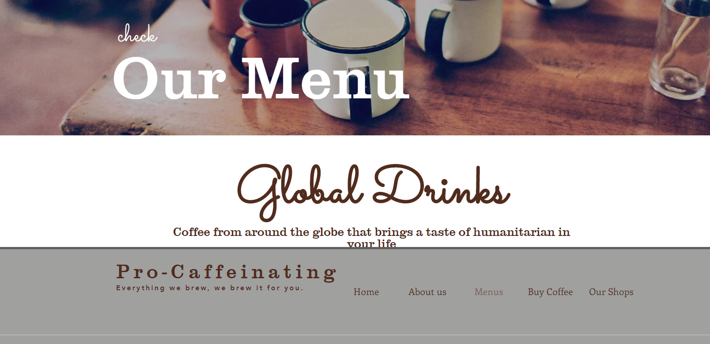
Our Website:
We are a Omni Website, meaning that we offer our customers the ability to shop in store as well as online.
Our website is designed to be simple and easy to navigate. When a customer logs into pro-caffeinating’s website, they will be greeted with our home page that explains who we are, where we are located, why ethical purchasing matters, and a selection of fair trade coffee.

Slide 11
Our Website:
We offer a variety of links for our consumer:
About Us: Gives the customer an overview of what Pro-Caffeinating is about and what we strive to achieve
Menus: Offers a closer look at our fair trade coffee
Buy Coffee: Connects consumers to our online shopping form
Our Shops: Offers more information about our two stores

Slide 12
Ordering from our website:
Orders for whole unground coffee beans by the pound can be placed on our website. We are currently shipping to the Continental US on standard fees, and Alaska and Hawaii for increased shipping fees.
To place an order, simply go to our website and click on Buy Coffee. You will be directed to our order form. Prices in house are the same as prices online. Shipping will be calculated based on location and amount ordered. You will have a choice between first class shipping or standard shipping.
If any product is damaged during shipping, or you receive the wrong product, please contact at us using the customer service number on our website. We will work with you to ensure you receive the corrected product.
20 percent of all money made from online orders goes towards maintaining our fair trade coffee farm partners.

Slide 13


We Are Mobile Friendly!
Check us out on our Mobile Website, learn about fair trade coffee on the go!
Don’t have enough time to chat? Be on your way with our online ordering tool. Place and pay for your order before you come in, and we’ll have it ready for you at the counter. No need to make small talk, just ethically sourced coffee on the go.

