Slide 1
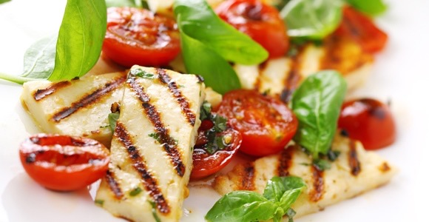

MEALS MADE E-Z
GROUP ONE
mealsmadee-z.weebly.com/

Slide 2
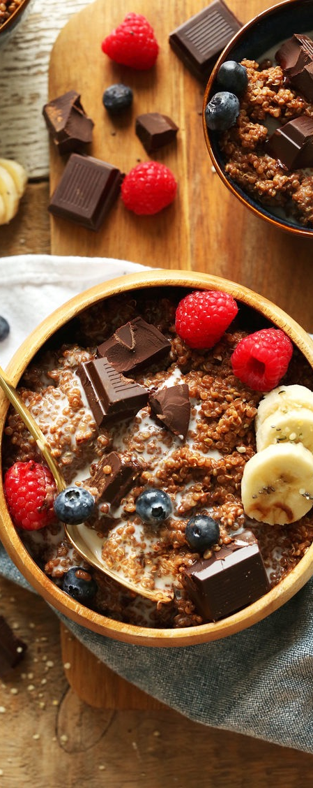
About Us
Our company offers customers a variety of daily meals that will be prepared using fresh products, free of GMO, no preservatives, low carb, no gluten, and organic.
The initial plan is to stay local in the Chicago area, within the first few months focusing on the River North area. We will continue to expand within large cities.

Slide 3
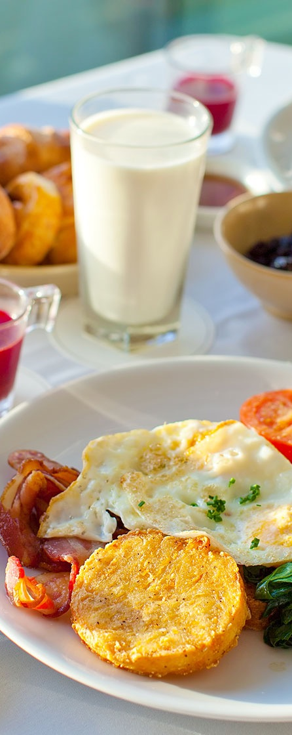
Our Goals
Healthy meals you can customize
Delivered right to your door
No mass production
Full course meals
Freshly prepared gluten-free, No-GMO, Organic
Affordable
Plan your menu for the next few days
Surprise your friends with quality homemade looking meals!
Our profit will be based on the markup applied to the cost of the meal plus the Uber delivery

Slide 4

Who Are our Prospect Customers?
Working professionals who don't have time to go home and prepare meals.
Age: 25-40
Health conscious
Mostly single, not married
Household income over $90,000
Statistics about River North
https://www.point2homes.com/US/Neighborhood/IL/Cook-County/Chicago/River-North-Demographics.html

Slide 5
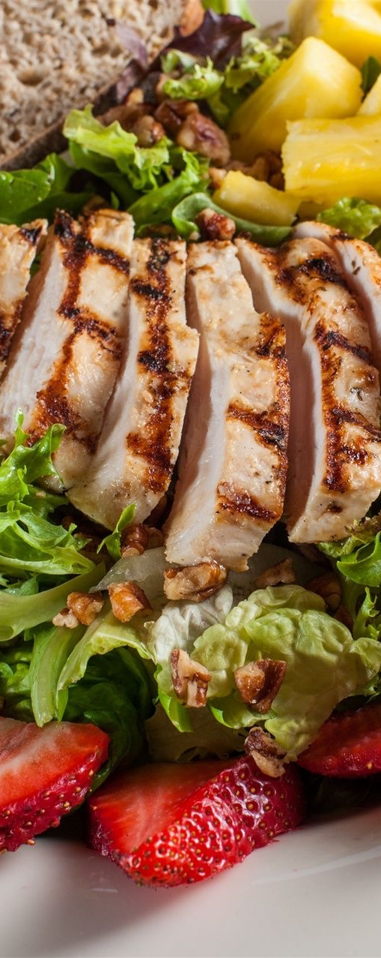
Business Strategies
We are planning to partner with local restaurants who will have to prove to us the quality of their meals. Our web based system will be a medium connecting customers with the suppliers – restaurants.
Restaurants will use our packaging with our branding to make sure the food is delivered hot and the driver carrying the meals from the car to the customer will also serve as our advertisement.
Partner with Uber for fast and easy delivery of the meals. On time, fresh and warm.

Slide 6
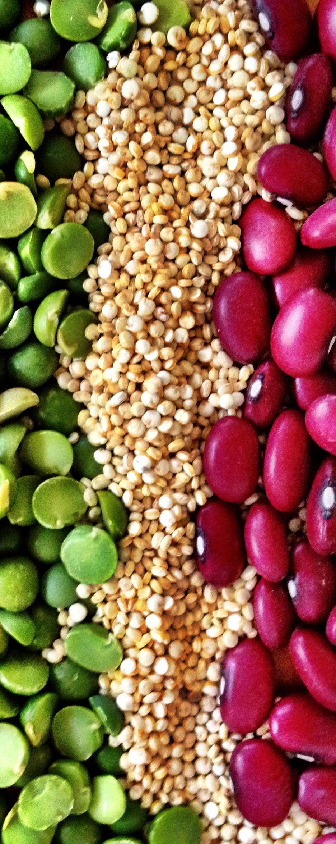
Website – let’s see what we’ve built
https://mealsmadee-z.weebly.com/

Slide 7
Estimated Cost of Running On-line Store
$300 annually (domain + hosting at weebly.com)
Merchant fees – the fees vary by type of credit card and gateway used. Depending on the plan selected, the cost will be between $100-$250 per month
Advertising – we would use social media sites and Google AdWords. The Google AdWords will allow us to specify the monthly budget and we can track how successful the campaign is.

Slide 8
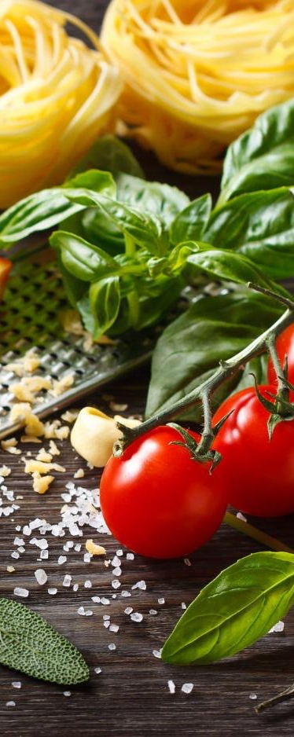
Future Website Enhancements
Mobile application
Gather real customers testimonials
Allow customers to rate the meals
Like us on Facebook, share with Twitter, etc.
Groupon – get on the Groupon platform to spread the word about the site
Special discounts – since we want start locally
Nutritional information about our meals
People to write articles, news section, recommendations
Yelp? Will that be something we want to consider or not? Since our site won’t be about a specific restaurant

Slide 9
Questions?

