Slide 1
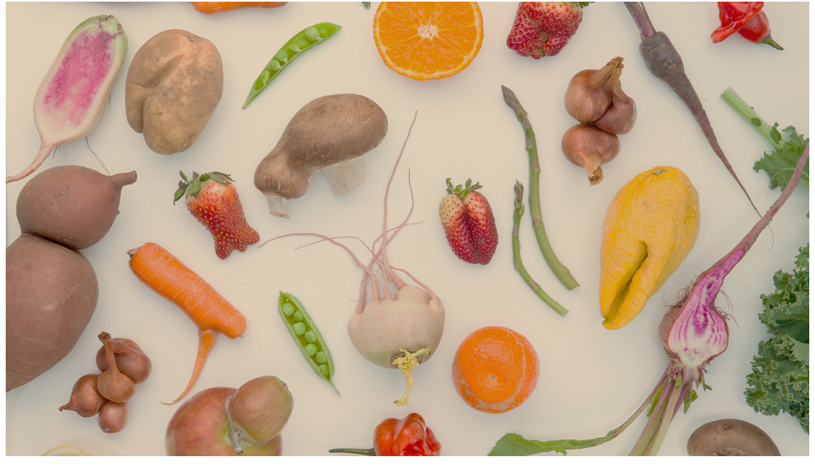
The Ugly Food Network
https://dianaarelihernande.wixsite.com/team5
MGMT 607: Management Information Systems
Fall 2017
Team 5: Duaa Altuwariqi, Betty-Jean Antwi, Diana A Hernandez Lopez and Imani Vaughan
Notes:
Imani

Slide 2
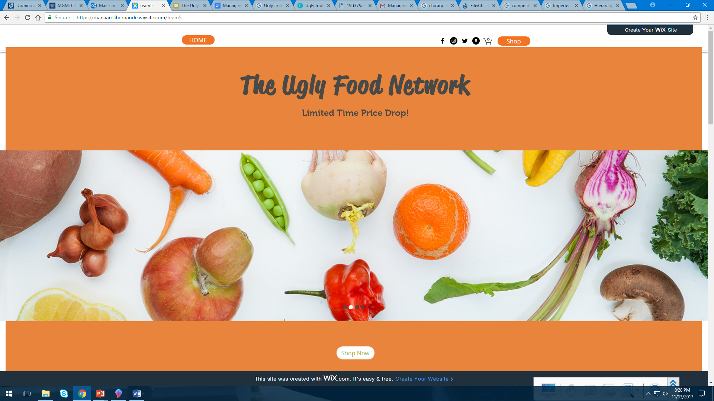
Overview
Who Are We?
Definitions of “Ugly Food”
Business Strategy
Web strategy
Type of Business
Scope, Target Market
Social Responsibility
Hierarchy: Functions from the website
Payment System
Competitors
Partnerships/Suppliers
Notes:
Imani

Slide 3
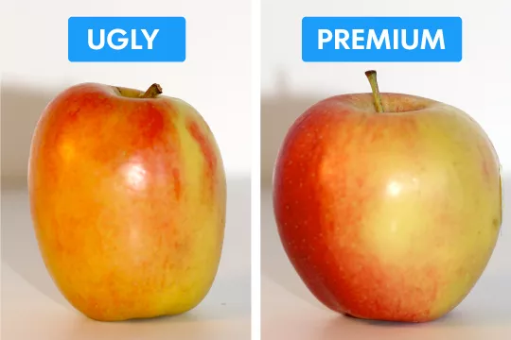
Who Are We?
Ugly Food Network is a social enterprise business that was created as a solution for the food desert problem in Chicago and food waste problem in Illinois.
Our main focus is to increase food security in Chicago while improving nutrition and reducing poverty. We operate to serve discarded or “ugly” produce at a discounted price in neighborhoods with little access to fresh healthy food.
Notes:
Betty
and those who are interested in building a sustainable food system.
UFN is a social enterprise organization. Our main focus is to increase food security in Chicago while improving nutrition and reducing poverty. We, operate to serve discarded or “ugly” produce at a discount in neighborhoods with little access to fresh, healthy food mainly and those who are interested in building a sustainable food system. Our phone application and web as well as our stands in the poor neighborhoods of Chicago will make us available to provide our customer with different options of fruits and vegetable, which is at affordable prices

Slide 4
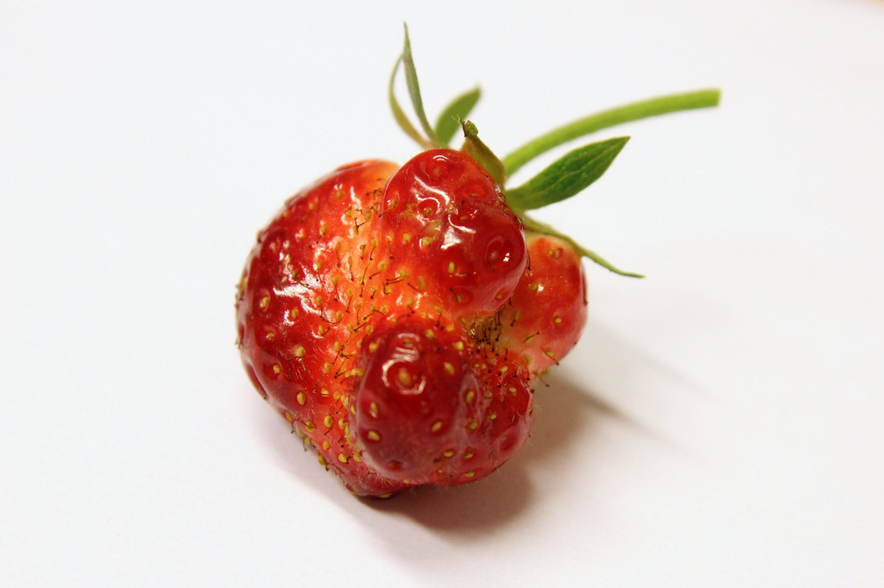
What is an “Ugly” Food?
Ugly Foods are freshly grown products that are denied entry into the grocery store market because of their figure deformities.
They are offered at food pantries and farmers markets at a discounted price.
Notes:
Betty

Slide 5
Objective
Our goal is to stop “food waste” by utilizing ‘ugly’ produce and reduce the food desert by being accessible for our society.
Our Vision is to provide better lifestyle choices and better use of resources.
Our Mission
We commit to provide better choices for people who live below the poverty level with the option of healthier choices of fruits and vegetables in affordable prices. We also commit to save the misfit resources of fruit and vegetable that do not meet the market standard, but are equally nutritious.
Notes:
Duaa

Slide 6

Product Offering
We offer various products that was produced and denied entry to the market based on their deformed appearance. Products such as,
Fruits
Vegetables
Seasonal items
We provides our imperfect product of fruit and vegetable from 20% to 40% less than the regular market.
Notes:
Duaa

Slide 7
Business Strategy
Our business strategy is to place the ugly produce back on the market.
Low Cost:
Partner with local food farmers .
Offer pop up stands to eliminate building, plant, and equipment expenses.
Differentiation:
We offer products that are highly differentiated from similar products (Ugly Foods).
We offer our imperfect products of fruits and vegetables from 20% to 40% less than the regular market.
Notes:
Diana

Slide 8




Web Strategy
Our web strategy consists on having a website and a shop available for our customers. Taking advantage of the Social Media to get to our customers. The social media platforms that we will utilize are the following:
Social Media:
Facebook
Twitter
Instagram
Snapchat
YouTube
App:
Available in the Apple Store and Windows Store.
Ugly Food Network
Notes:
Diana
Our web strategy consist on having a website that presents our business mission, vision, as a solution to the problem of food waste and food desert in Chicago; it also presents our products to our potential customers. Additionally, we will launch an app to present our available products and deliver them to our customers (?) We intend to be a digital business without a Warehouse (?) to reduce costs and increase profit.
Social Media:
Facebook
Twitter
Instagram
Snapchat
YouTube

Slide 9
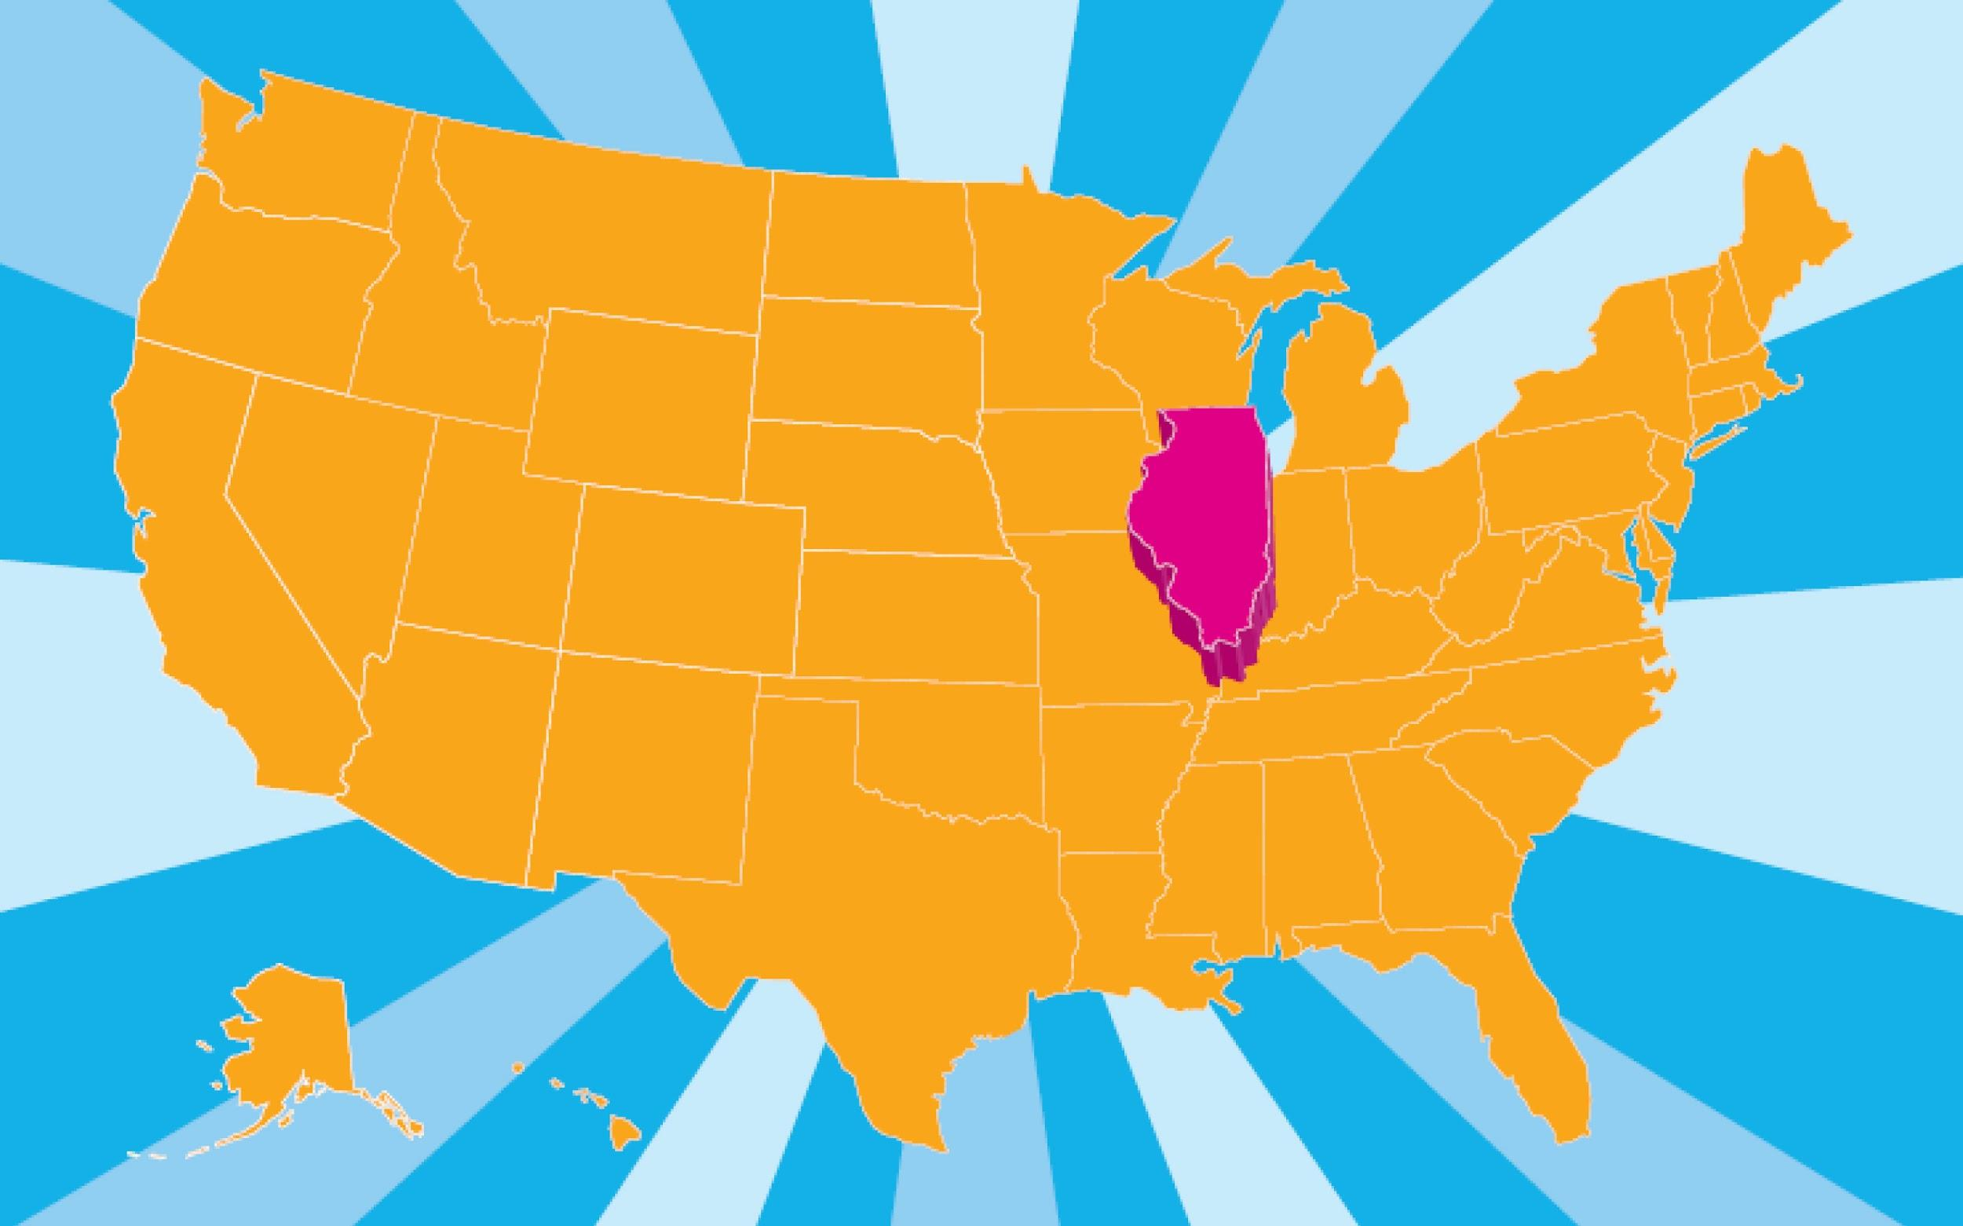
Scope
Our scope is currently limited to operate only in Illinois, providing delivery service, pop-up farmer markets and online within the state and being available in the market.
Notes:
Imani

Slide 10
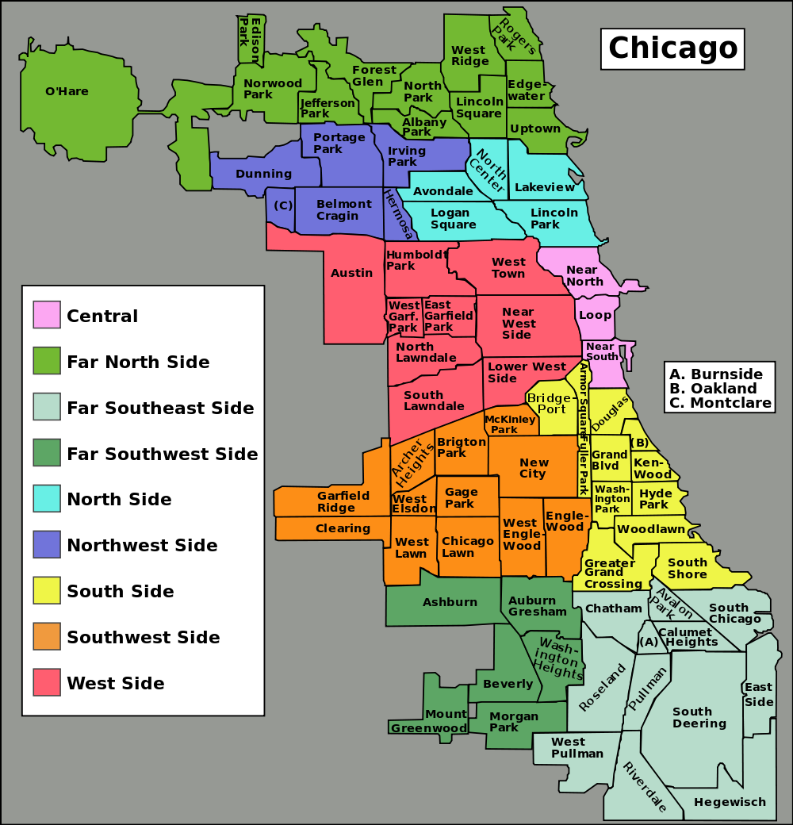
Target Market
Our main target market are individuals and families in the low income communities throughout chicago IL. Communities such as,
Austin
Lawndale
Garfield park
Lincoln square
South Shore
Beverly
Notes:
Imani

Slide 11

Social Responsibility
Our goal is to stop “food wasted” by finding place for ‘ugly’ produce, and reduce the food desert by being accessible for our society.
Reduce food waste.
Reduce hunger and starvation.
Supply food in local food desert areas.
Notes:
Betty
While there are 600,000 people in food deserts in Chicago, which is 22% of Chicago’s population (NBC 2010), there are about sixes billion pounds of U.S. fruits and vegetables go unharvested or unsold because of aesthetic reasons. These fruits and vegetables that have been rejected in the market because aesthetic reasons, but these product still nutritious and have the same value on the regular one.

Slide 12
Hierarchy
Functions from the website
Notes:
Betty

Slide 13
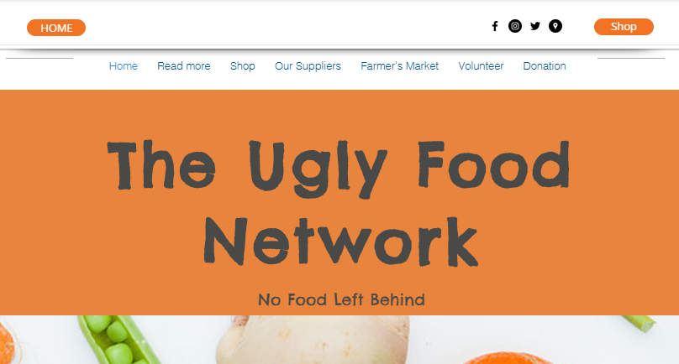
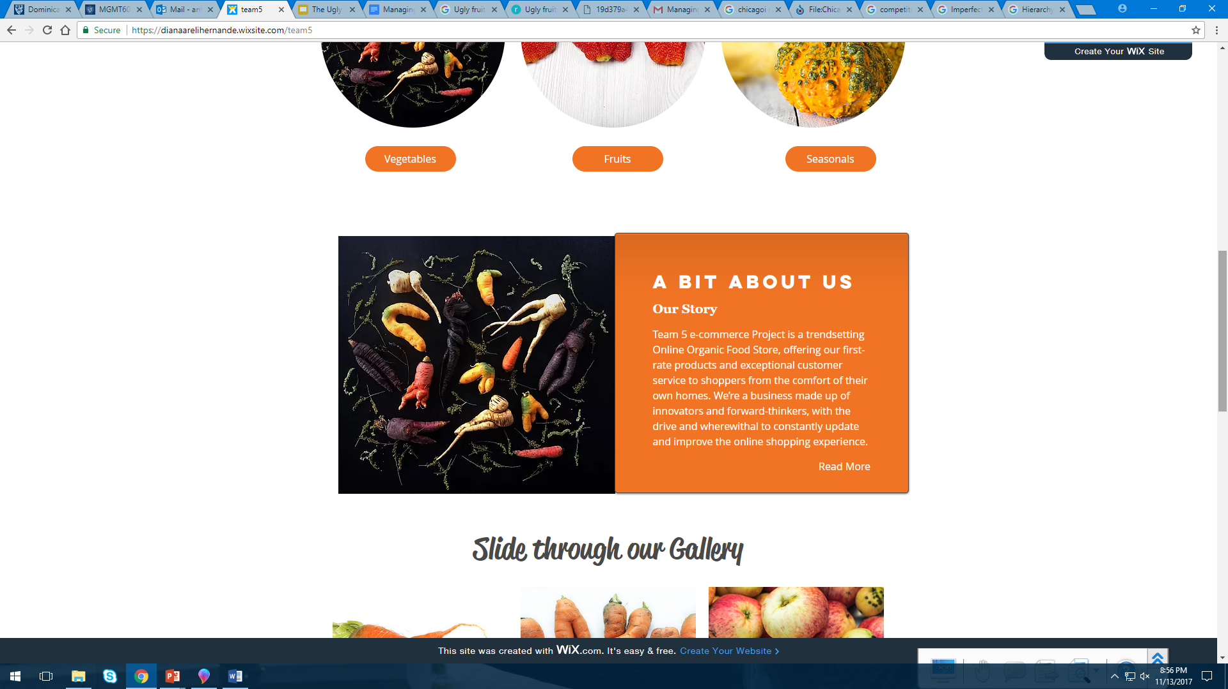
Functions from the website
Home
The main page includes an overall view from our business. There is access to every section of our website from Home:
About us
Shop
Our Suppliers
Farmer’s Market
Volunteer
Donation
About Us
Available on Home page
Includes a brief history of our organization:
our goal
our mission
our vision.
Notes:
Duaa
Home
The main page of our website,
includes a presentation of our business, categories of our products and In the Home page, the customers can find a section about us and our history, which lead to another page with more information. The customer can find at the bottom of the home page a section to contact the organization and links to our social media accounts.
At the top of the home page there is another set of social media links, next to our Shopping cart and a link
About Us
Available on Home page
The page “About us” will include a brief history of our organization, our goal, our mission, and our vision.
We intend to share our mission with our customers to create a change in Illinois.

Slide 14
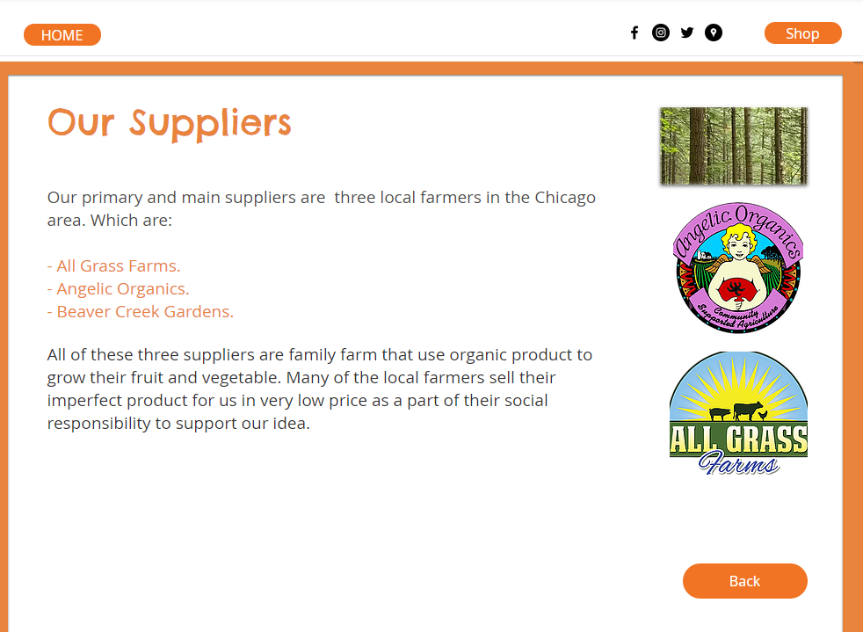
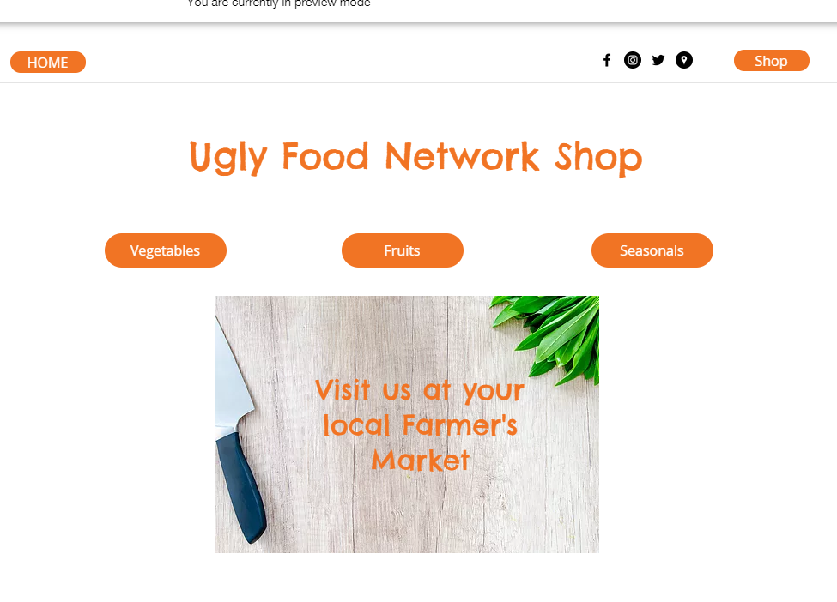
Functions from the website
Suppliers
This page is available from our Home page. We recognize our suppliers and partnerships. This enables a form of advertisement.
Shop
This page is our most important section, is available from every page in the website.
It includes our three categories:
Fruits
Vegetables
Seasonal
Notes:
Duaa
Suppliers
This page is available from our Home page. The page “Suppliers” include a description of part of our procedures and present our local suppliers to our customers, presenting a form of advertisement that will help us earn some revenue. Here we will include our partnerships and Donors.
Shop
This page is our most important section, is available from every page in the website. The Shop page along with the shopping cart is available from all the pages. It includes our three categories (Fruit, Vegetables, and Seasonal) and a list of all the available products. We included some flexibility in the shop to allow our customers go back and forth from our home page to the shop and vice versa.

Slide 15
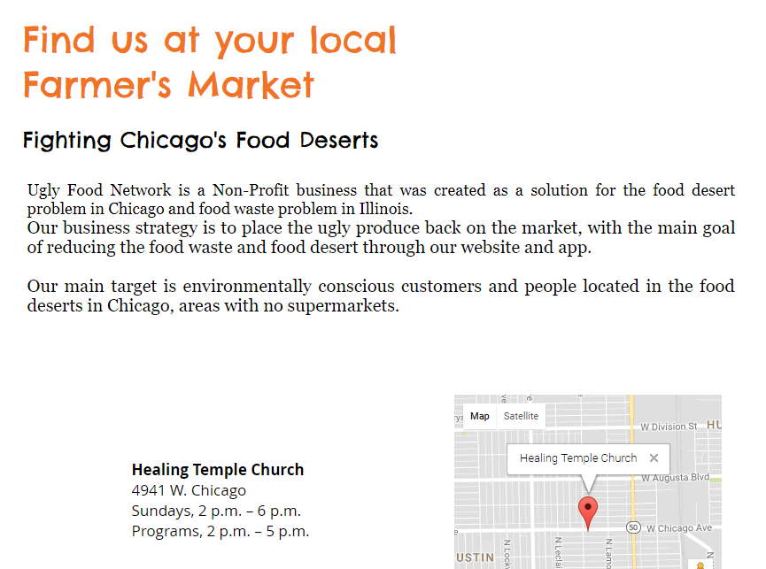
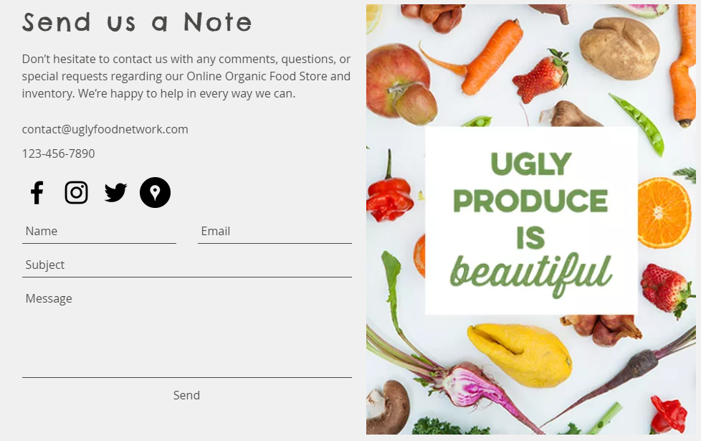
Functions from the website
Farmers Market
Available from home page and Shop.
We present the location of our Farmer’s Market in Illinois.
Contact
This section in the Home page allows our customers to get in touch with us, share comments, questions, etc.
Notes:
Diana
Farmers Market
This page will be available from our home page and from our shop page. Here we will include the locations of our farmers Market in Illinois. It will talk more about the food deserts and the dates of availability in the FM.
Contact
This section does not own a page by itself but is included at the bottom of the Home page and allows our customers to get in touch with us, share any comments, questions, or special requests regarding our Online store, Farmers Market, or inventory. We also provide our e-mail address for the ones that want to do it directly.
Besides the contact features, we present a link to our Social Media Profiles, to engage with our customers, affiliates, donors, partners, and future customers.

Slide 16
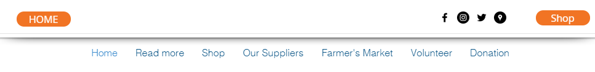
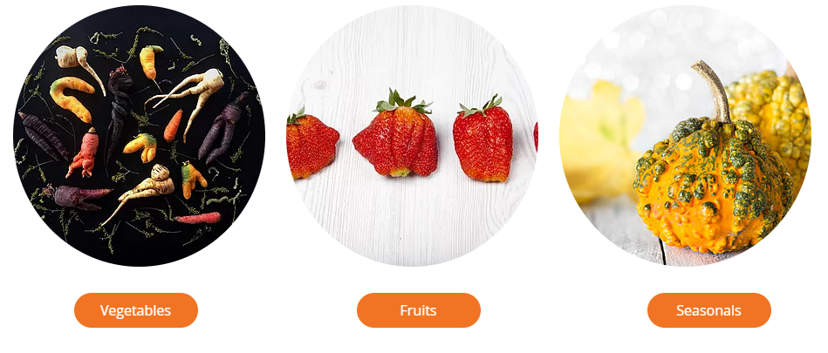
Functions from the website
Header
The header for our website includes different set of buttons that will allow the customer to navigate easily through our website.
Display of products
We divide our products in three categories:
Fruits
Vegetables
Seasonals.
Our categories are presented in our Home page and can be accessed from different pages.
Notes:
Diana
Header
This header remains the same along all the pages. First, the Home button that will bring flexibility of navigation, and the shop access next to the shopping cart. Our social media will be accessible from every page as well.
Display of products
We aim to bring an easy shopping experience for our customers, that is why we are not planning to create a subscription. We pretend to eliminate this extra step to attract more customers.

Slide 17
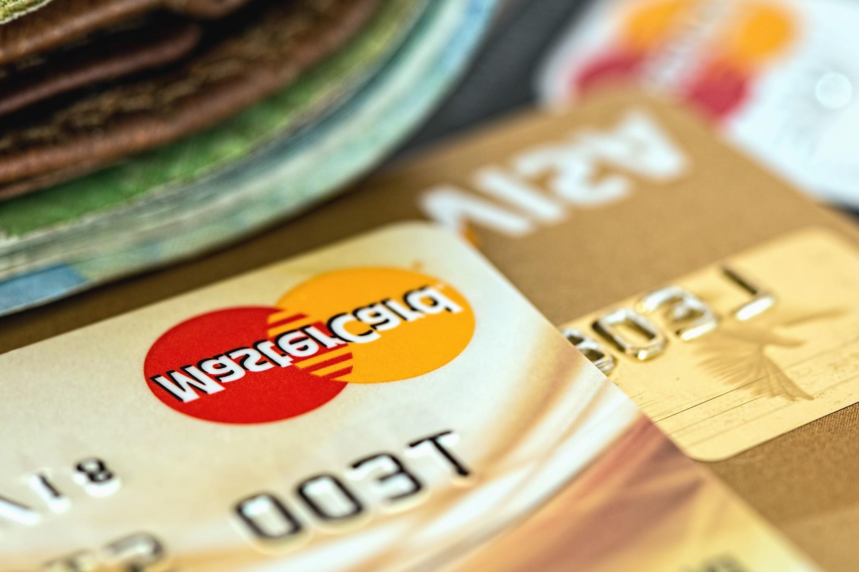
Payment System
We accept 3 different forms of payment.
Cash
Credit/ Debit Card
(Visa, Mastercard, Discover, and American Express.)
Supplement Nutrition Assistance Program
Link card/EBT
Notes:
Imani

Slide 18

Do We Have Any Competitors?
The only direct competitor to us is Imperfect Produce Company
IPC is a direct a for-profit company located in Los Angeles that specializes in sales of fruits and vegetables that don’t meet the grocery stores' standards to sell.
Notes:
Betty

Slide 19
Partnership/Suppliers
Our primary partners and suppliers are local farmers such as,
All Grass Farms
Angelic Organics
Beaver Creek Gardens
We partner with three main local farmers in the Chicago area. All three suppliers are local family farmers, that use organic products to grow their fruits and vegetables. Many of the local farmers sell their imperfect products to us for a very low price as a part of their social responsibility to support our idea.
Notes:
Duaa

Slide 20
Conclusion/Summary??
Notes:
Diana

Slide 21
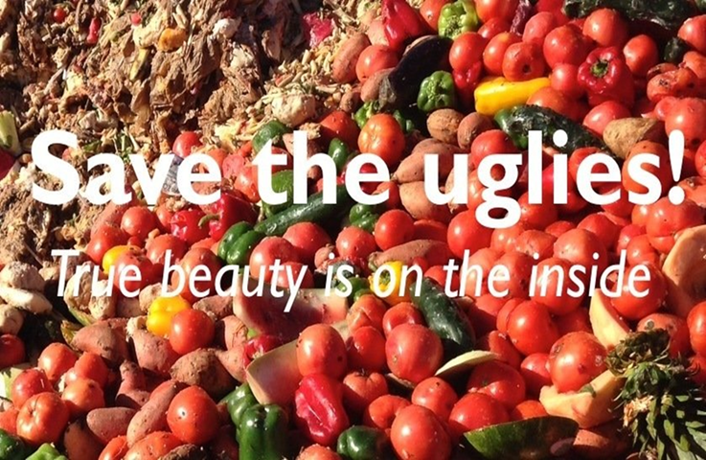
Thank you for Listening!

